Slide 1
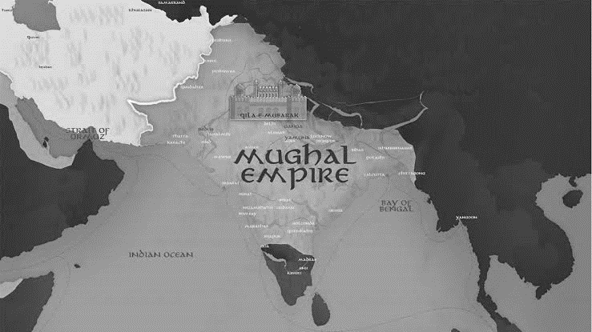
The Mughal Empire: The Reign of the First Six Emperors

Slide 2
Table of Contents
Introduction
Overview of the Mughal Empire
Significance of the First Six Emperors
Babur (1526-1530)
Background and Lineage
Conquest of India
Achievements and Legacy
Humayun (1530-1556)
Challenges Faced
Exile and Return
Cultural Contributions and Legacy
Akbar the Great (1556-1605)
Early Life and Ascension
Policies of Religious Tolerance
Administrative Reforms
Cultural Influence and Legacy
Jahangir (1605-1627)
Personality and Interests
Relationship with the British
Art and Culture During His Reign
Legacy

Slide 3
Table of Contents
Shah Jahan (1628-1658)
Architectural Marvels
Contributions to Mughal Art and Culture
Influence on the Empire
Aurangzeb (1658-1707)
Territorial Expansion
Religious Policies
Impact on the Empire
Impact of the First Six Emperors
Shaping of the Mughal Empire
Contributions to Art, Culture, and Governance
Decline of Mughal Empire
Factors Contributing to Decline
Challenges Faced by Later Emperors
Ultimate Fate
Conclusion
Summary of Key Points
Significance of the First Six Emperors
Thank You

Slide 4
Introduction to Mughal Empire
The Mughal Empire was a powerful and influential dynasty that ruled over the Indian subcontinent for several centuries.
It left an indelible mark on the history, culture, and heritage of the region.
Its rise marked a unique fusion of Persian, Indian, and Central Asian cultures, resulting in an empire known for its architectural wonders, artistic achievements, and religious tolerance.
At its zenith, the Mughal Empire was a testament to human creativity and ambition, producing iconic landmarks like the Taj Mahal and intricate Mughal miniature paintings.

Slide 5
Introduction to Mughal Empire
This introduction sets the stage for an exploration of the Mughal Empire, with a particular focus on its first 6 emperors.
In this presentation, we will explore the reign of the first 6 Mughal emperors: Babur, Humayun, Akbar the Great, and Jahangir.
These emperors played a pivotal role in shaping the empire and its historical legacy.

Slide 6
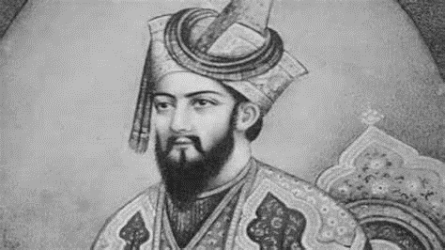
Babur (1526-1530)
Babur, the founder of the Mughal Empire, was born in 1483 in Andijan, present-day Uzbekistan.
He belonged to the Timurid dynasty, descending from Timur on his father's side and Genghis Khan on his mother's side.
In 1526, he famously defeated Ibrahim Lodhi at the First Battle of Panipat, establishing the Mughal rule in India.
Babur is renowned for his memoir, the "Baburnama," which provides valuable insights into his life and times.
His legacy includes the establishment of the Mughal Empire in India, which laid the foundation for future rulers.

Slide 7
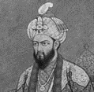
Humayun (1530-1556)
Humayun, the son of Babur, ascended to the Mughal throne in 1530.
His reign was marked by several challenges, including
internal strife and external threats from Sher Shah Suri.
Humayun faced exile and spent several years wandering in the Safavid Empire before regaining his throne.
He contributed to the cultural development of the Mughal Empire, particularly in the realms of art and architecture.
His legacy includes the preservation of the Mughal Empire, which his son Akbar would later expand and strengthen.

Slide 8
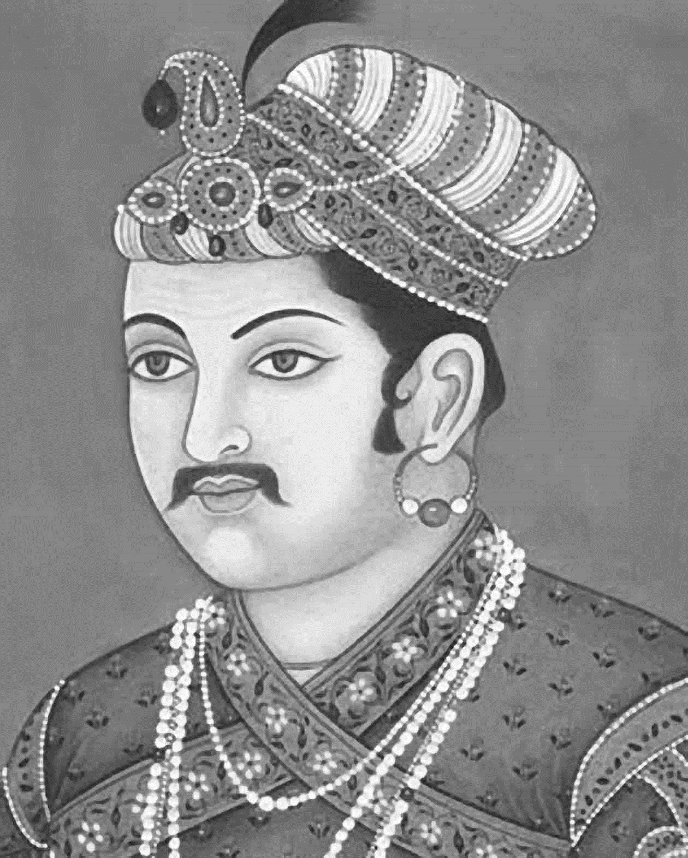
Akbar the Great (1556-1605)
Akbar, also known as Akbar the Great, was born in 1542 and ascended to the throne at a young age.
He is celebrated for his policies of religious tolerance, which promoted harmony among the diverse communities in his empire.
Akbar implemented significant administrative reforms, including the introduction of the Mansabdari system.
His patronage of art, culture, and literature resulted in the flourishing of the Mughal Renaissance.
Akbar's legacy includes a united and prosperous Mughal Empire and a rich cultural heritage.

Slide 9
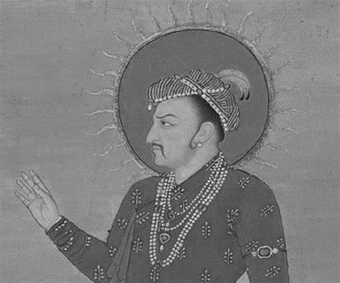
Jahangir (1605-1627)
Jahangir, known for his keen interest in art and nature, was an emperor with a complex personality.
His reign saw the establishment of trade relations with the British East India Company.
He was an avid patron of art and culture, and his era is often referred to as the "Jahangirian Age" in Mughal art history.
Jahangir's legacy includes contributions to Mughal art and a period of relative stability during his rule.

Slide 10
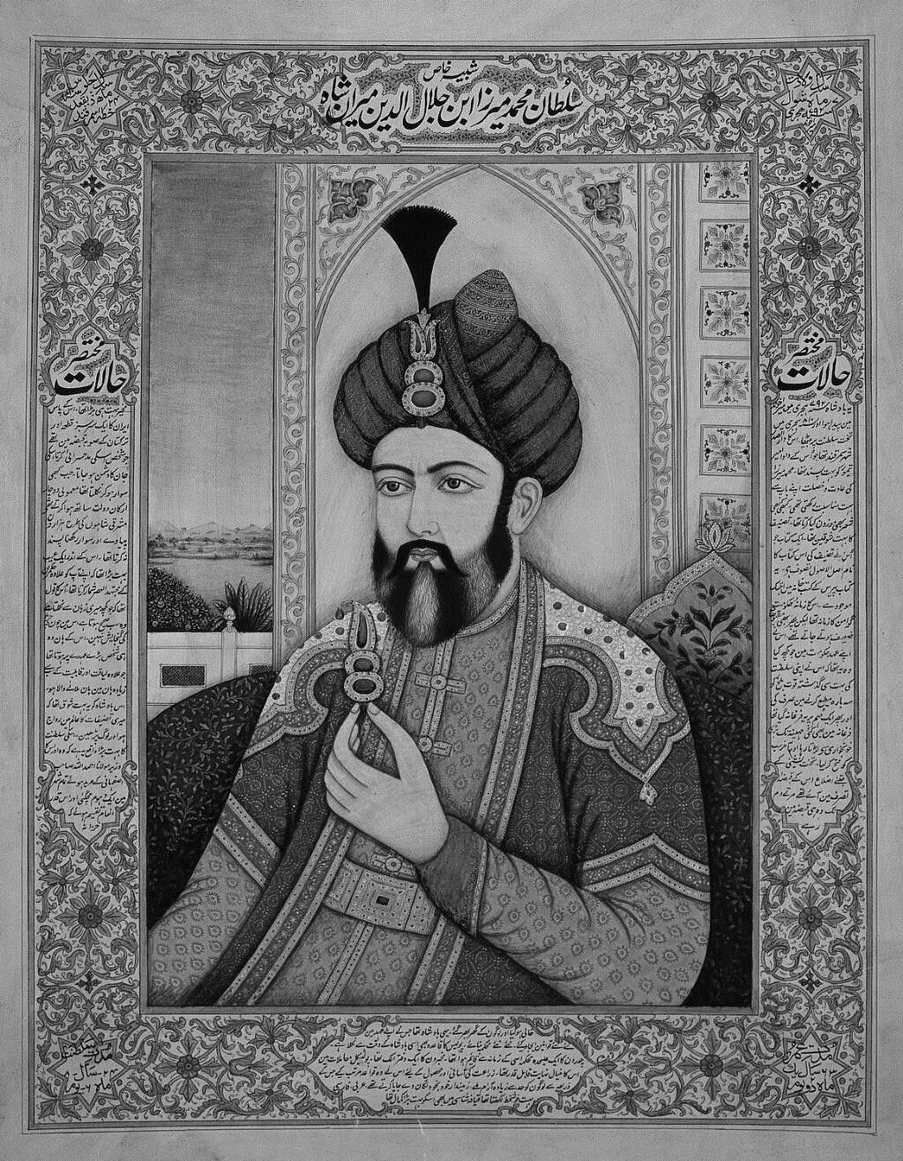
Shah Jahan (1628-1658)
Shah Jahan, the fifth Mughal emperor, is perhaps best known for commissioning the construction of the world-famous Taj Mahal in memory of his beloved wife Mumtaz Mahal.
Under his rule, the Mughal Empire reached the zenith of its architectural achievements, with other remarkable structures like the Red Fort in Delhi.
Shah Jahan's reign was marked by his dedication to art and architecture, as well as his focus on maintaining the grandeur of the empire.

Slide 11
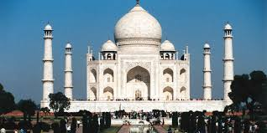
However, his later years were marred by political strife, including a conflict with his son, Aurangzeb, which led to his house arrest.
Despite the challenges, Shah Jahan's architectural and cultural contributions endure as enduring Symbols of Mughal magnificence.

Slide 12
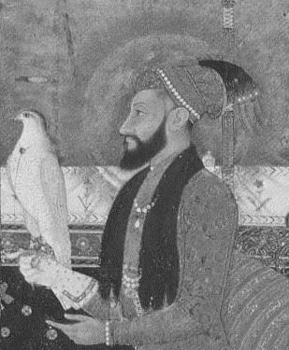
Aurangzeb (1658-1707)
Aurangzeb, the sixth Mughal emperor, had one of the longest and most tumultuous reigns in Mughal history.
He expanded the empire to its greatest territorial extent, but his rule is also remembered for its religious orthodoxy and authoritarian policies.
Aurangzeb's reign saw conflicts with various religious and regional groups, including the Sikh Guru Gobind Singh and the Marathas.
He imposed restrictions on non-Muslims and pursued a policy of religious centralization.

Slide 13
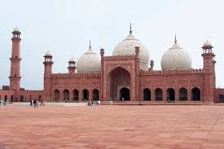
Despite his military prowess and territorial gains, Aurangzeb's rule is often viewed as contributing to the decline of the Mughal Empire due to its religious intolerance and the strain it placed on the empire's resources.
His reign marked a turning point in Mughal history, as the empire began to weaken and fragment in the years following his death.

Slide 14
Impact of the First Six Emperors
Babur (1526-1530):
Founded the Mughal Empire with his victory at the First Battle of Panipat.
Introduced Central Asian influences, including the concept of a centralized empire.
Left a legacy of cultural exchange and early Mughal art.
Humayun (1530-1556):
Sustained the empire through challenging times, preserving Babur's legacy.
Contributed to the development of Mughal art and culture.
Reclaimed the empire after his exile, setting the stage for its continued growth.
Akbar the Great (1556-1605):
Implemented policies of religious tolerance, fostering unity among diverse communities.
Introduced administrative reforms like the Mansabdari system.
Patronized art, leading to the flourishing of the Mughal Renaissance.

Slide 15
Impact of the First Six Emperors
Jahangir (1605-1627):
Showcased a unique personality and interests, including a love for art and nature.
Developed trade relations with the British East India Company.
His era, known as the "Jahangirian Age," saw significant cultural achievements.
Shah Jahan (1628-1658):
Commissioned iconic architectural wonders, including the Taj Mahal and Red Fort.
Oversaw a golden age of Mughal art and culture.
His rule represented the pinnacle of Mughal architectural achievements.
Aurangzeb (1658-1707):
Expanded the empire to its greatest territorial extent.
However, his rule is controversial for its religious orthodoxy and authoritarian policies.
His reign marked a turning point in Mughal history, leading to the empire's eventual decline.

Slide 16
Decline of Mughal Empire
Factors Contributing to Decline:
Aurangzeb's Religious Policies: Aurangzeb's policies of religious orthodoxy alienated non-Muslim communities and led to internal strife.
Maratha and Sikh Resistance: The Marathas and Sikhs mounted formidable challenges to Mughal authority, gradually weakening imperial control.
Economic Strain: Costly military campaigns and the maintenance of a vast empire strained the Mughal treasury.
Succession Issues: The empire faced instability due to frequent succession conflicts and weak leadership.
European Colonial Powers: The emergence of European colonial powers, such as the British and French, posed external threats to Mughal territories.

Slide 17
Decline of Mughal Empire
Challenges Faced by Later Emperors:
Later Mughal emperors, like Bahadur Shah II, faced diminishing power and influence, reduced to being figureheads under the control of regional powers.
Ultimate Fate:
The decline culminated in the Indian Rebellion of 1857, also known as the Indian Mutiny or Sepoy Mutiny, which marked a turning point.
Following the rebellion's suppression, the British East India Company assumed direct control over much of India, effectively ending Mughal rule.
The decline of the Mughal Empire serves as a cautionary tale of the complex interplay of internal and external factors that can shape the destiny of empires. Its legacy, however,
endures in the form of art, architecture, culture, and the historical memory of an extraordinary era.

Slide 18
Conclusion
In conclusion, the reigns of the first six Mughal emperors - Babur, Humayun, Akbar the Great, Jahangir, Shah Jahan, and Aurangzeb - collectively shaped the Mughal Empire in profound ways. Their rule spanned a period of remarkable cultural, architectural, and political achievements, leaving an indelible mark on the Indian subcontinent and the world.
Babur's conquest marked the empire's inception, while Humayun's perseverance preserved it during challenging times. Akbar's policies of religious tolerance and administrative reforms laid the groundwork for a prosperous and harmonious empire. Jahangir's unique personality and cultural contributions enriched Mughal art, and Shah Jahan's architectural legacy, epitomized by the Taj Mahal, stands as a testament to Mughal grandeur. Lastly, Aurangzeb, with his territorial expansion and religious orthodoxy, marked a turning point in Mughal history.
The combined impact of these six emperors on the Mughal Empire was profound. Their contributions in art, governance, and territorial expansion, as well as their individual idiosyncrasies, defined an era that continues to captivate our imagination today. The Mughal Empire remains a testament to their enduring legacy.

